Slide 1
Obesity is a major global health problem
According to the World Health Organization:
Worldwide obesity has tripled between 1975 and 2016
Most of the world's population live in countries where overweight and obesity kills more people than underweight.
Being obese or overweight => results in
Greater risk of developing mental health disorders than non-obese people.
Mental disorders such as eating disorders, anxiety disorders
Serious health consequences than non-obese people.
Physical health problems such as suffering from strokes/ heart attacks, type 2 diabetes, having osteoarthritis
Luckily, there is a silver lining => Obesity is preventable.

Slide 2
Looking at “Obesity” dataset
Overview:
This dataset includes data for the estimation of obesity levels in individuals from the countries of Mexico, Peru and Colombia, based on their eating habits and physical condition.
Contains 17 attributes and 2111 records
Records are labeled with the class variable NObesity (Obesity Level) that allows classification of the data (below shows the increasing levels of obesity):
Insufficient Weight
Normal Weight
Overweight Level I
Overweight Level II
Obesity Type I
Obesity Type II
Obesity Type III
77% of the data was generated synthetically using the Weka tool and the SMOTE filter
23% of the data was collected directly from users through a web platform
Dataset is extracted from the website below:
http://archive.ics.uci.edu/dataset/544/estimation+of+obesity+levels+based+on+eating+habits+and+physical+condition
name of the dataset is “ObesityDataSet_raw_and_data_sinthetic”

Slide 3
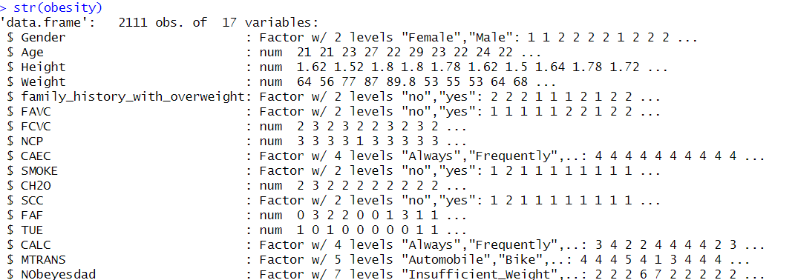
Structure of the dataset
2111 records with 17 variables which is a combination of numbers and factor data types.

Slide 4
Explanation of the variables
Attribute | Description
Gender | Sex - Female/Male
Age | Age - Numeric value
Height | Height- Numeric value in meters
Weight | Weight- Numeric value in kilograms
FHWO | Overweight family members: Has a family member who suffered or suffers from overweight - Yes/No
FAVC | Consume high-calorie foods frequently - Yes/No
FCVC | Number of meals where you usually eat vegetables - Numeric value
NCP | Number of main meals a day - Numeric value
CAEC | Eat food between meals - No/Sometimes/Frequently/Always
SMOKE | How often you smoke - Yes/No
CH2O | Liters of water you drink a day - Numeric value
SCC | Monitor the calories you consume daily - Yes/No
FAF | Frequency of days per week that you often have physical activity - Numeric value
TUE | Time of use of technological devices on a daily basis - Numeric value
CALC | Frequency of alcohol intake - No/Sometimes/Frequently/Always
MTRANS | Means of transportation that you use regularly - Automobile/Motorbike/Bike/Public/Transportation/Walking
NObeyesdad | Obesity Level based on body mass index - Insufficient Weight/Normal Weight/Overweight Level I/Overweight Level II/Obesity Type I/Obesity Type II/Obesity Type III

Slide 5
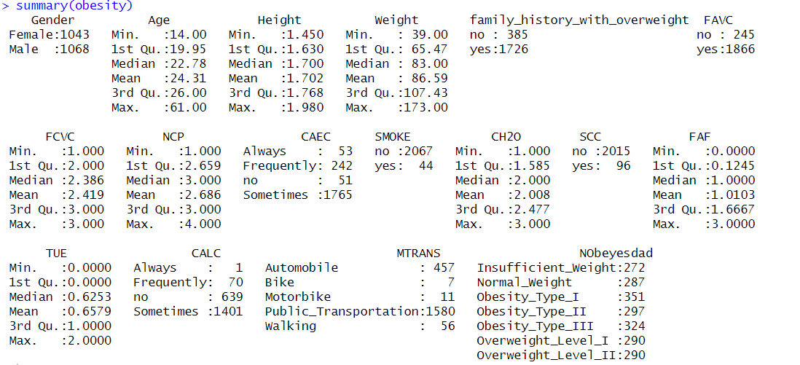
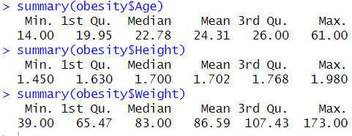
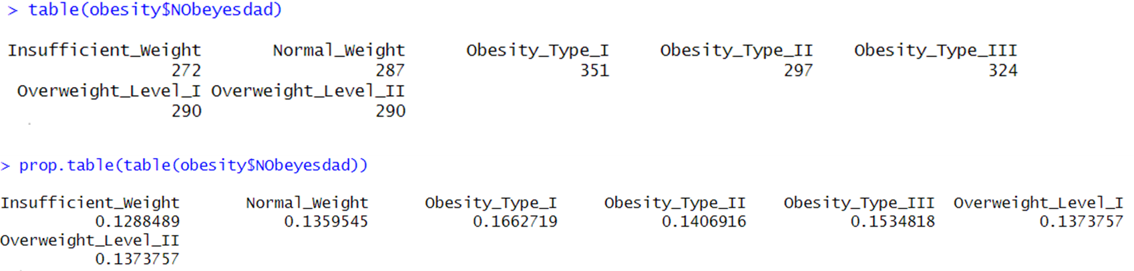
Summary of the dataset
Each respondent’s:
age ranges from 14 – 61 years old
height ranges from 1.45m to 1.98m
weight ranges from 31kg to 173kg
Median age is 22.78; median height is 1.7m; median weight: 83kg
Majority (more than 70%) of the respondents are obese or overweight => worrying trend

Slide 6
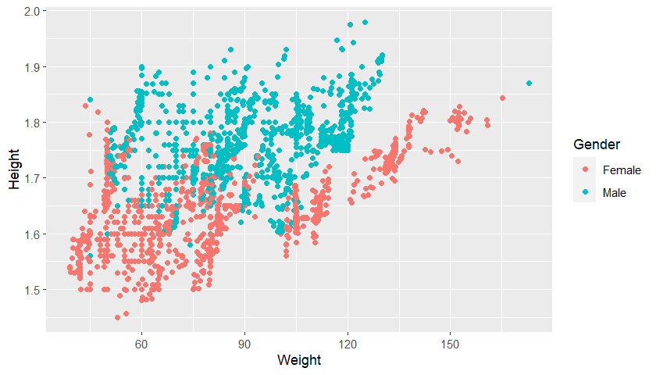
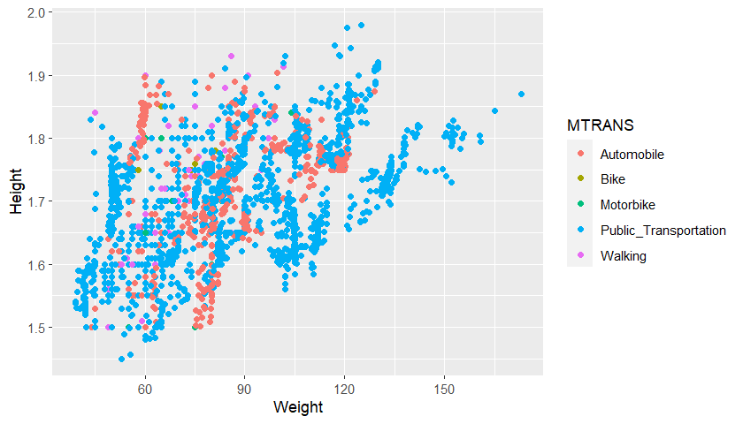
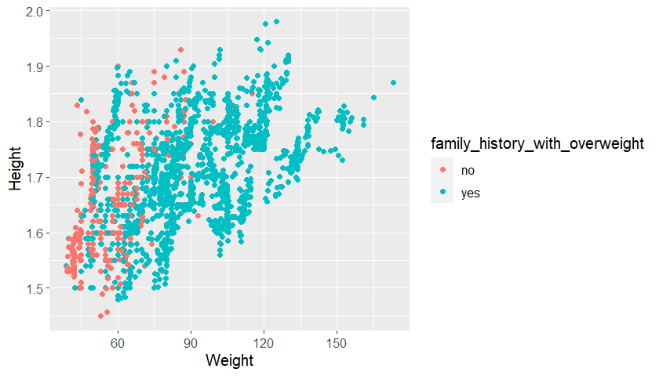
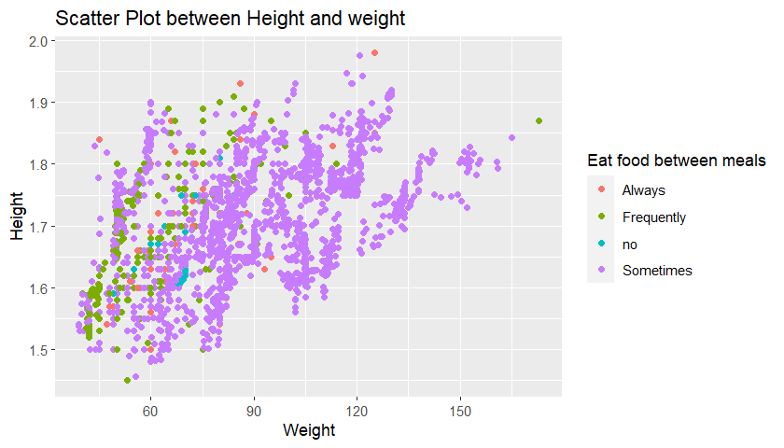
Exploration of data
Having walking or bike as a means of transportation helps prevent obesity
Women are more obese than men especially seen in the red box
Having frequent small meals is better than having few large meals in terms of weight control
Strong relationship between someone who is obese and with family members who have someone obese

Slide 7
Objective problem statement
To implement the data analytic technique (decision tree)
Correctly classify the obesity levels of the records based on variables and physical characteristics (e.g., weight and height) and
Determine if one suffers from obesity
It would then be useful in helping many people as well as health professionals to see how best to get these obese people to achieve a healthier lifestyle.

Slide 8
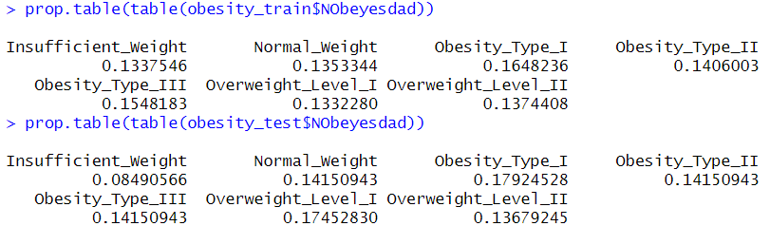
Methodology
Include set.seed(123) before creating random train data and test data so that the same results can be replicated
90% of the data set was for training (train data), and the remaining 10% was used for testing the algorithms (test data)
I.e., n=1899 (train data); n=212 (test data)
Performed a random sampling of the obesity data for training since the last 212 records of the obesity dataset all are of the same obesity type - Obesity_Type_III. It would be problematic if the dataset is used as it is as the test dataset is not represented across the 7 different obesity types.
After random sampling, the below shows that the proportion of all obesity types across train data and test data is quite alike as shown in the diagram below.

Slide 9
Why use Decision Tree?
Supervised learning algorithm
Take the analyzed data and use a representation in a tree data structure, to provide better insight of the information from the data.
Considered one of the classification algorithms with high-performance
More popular ones have been implemented in several tools such as ‘C4.5’ and ‘C5.0’.
For this dataset, we are using the C5.0 algorithm in the C50 package to train our decision tree model.
The C5.0 algorithm offers many more options to tailor the model to a particular learning problem.

Slide 10
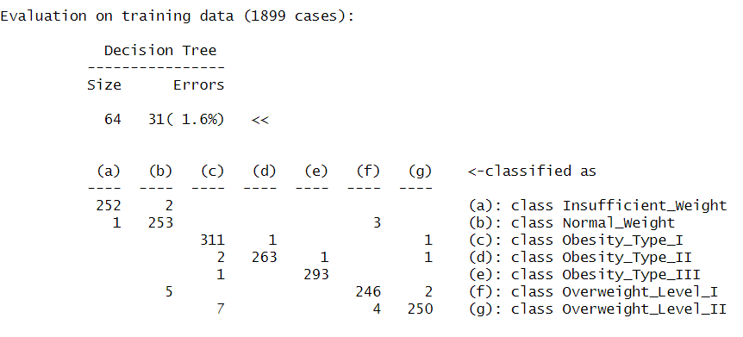
C5.0 decision trees Evaluation of model on train data
The 17th column in obesity train data is the ‘Nobeyesdad’ class variable => Excluded from train data but supplied it as the target factor vector for classification.
Prediction accuracy on train data is high since the errors are only 1.6%
This model correctly classified all but 31 of the 1899 training instances for an error rate of 1.6%; the tree size is 64.
False Positives
2 observations from class a (Insuffifient_weight) is incorrectly classified as class b (Normal_weight)
While 7 observations from class g (Overweight_Level_II) is misclassified as class c (Obesity_Type_I)
False Negatives

Slide 11
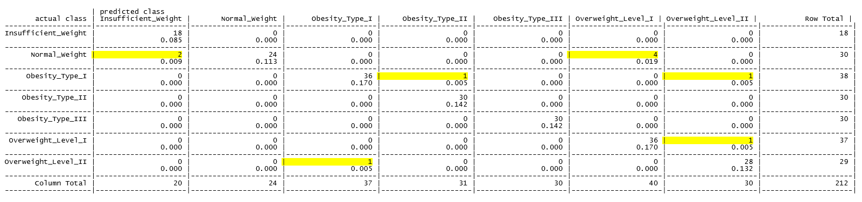
C5.0 decision trees Evaluation of model on test data
Out of 212 records, only 10 records (highlighted in yellow) in the table above are incorrectly classified.
Errors are only 4.7% -> As expected since the decision tree has a problem of overfitting issue (overfitting the model to the train data)

Slide 12
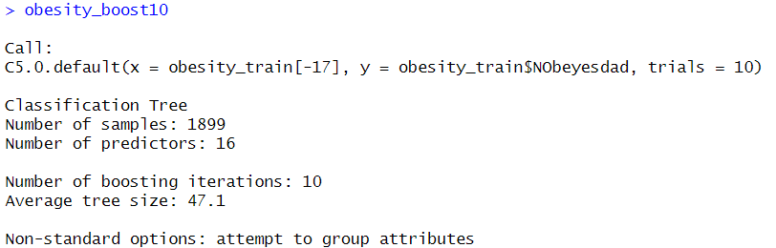
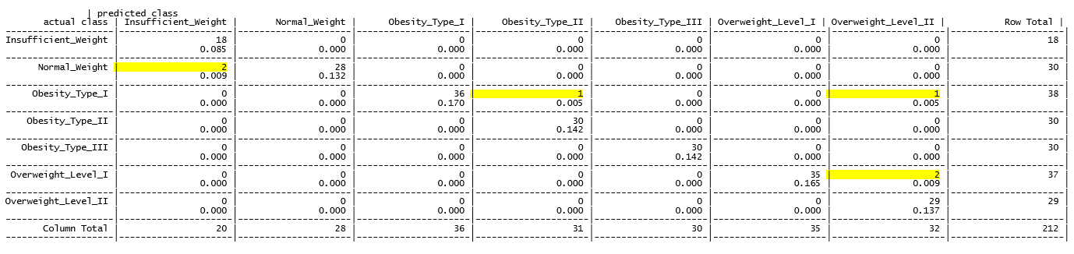
Boost the accuracy of C5.0 decision trees
Improve the C5.0 algorithm through the addition of adaptive boosting
Easy to boost the decision tree by adding additional ‘trials’ parameter
Results:
Tree size has shrunk from 64 to 47.1
Starting with 10 trials (a number that has become the de facto standard)
Previously 10 observations are incorrectly classified => Now only 6 observations are incorrectly classified

Slide 13
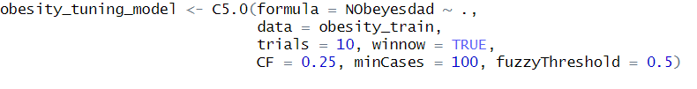
Tuning of other parameters
Besides tuning of ‘trials’ parameter as seen in the addition of adaptive boosting, we can also tune using other parameters seen in the model below:
By setting winnow to TRUE, irrelevant attributes are removed from model
Complexity parameter:
Controls the size of the tree
Minimum number of cases/samples required for a node to be split
Controls how the algorithm handles numeric attributes

Slide 14
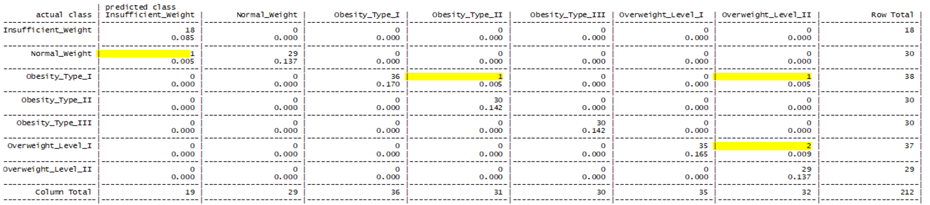
Evaluation of model after tuning of parameters
The result is the same as just tuning the “trials” parameter as seen in the addition of adaptive boosting.

Slide 15
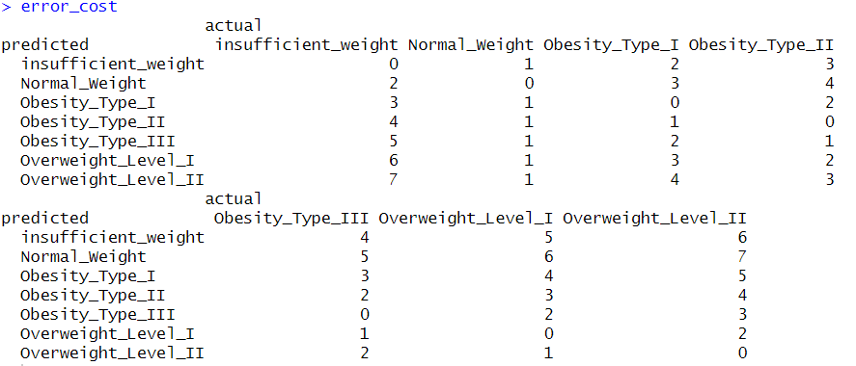
Setting up a cost matrix
There should be a cost given for each incorrect classification.
Depending on the severity of the incorrect classification
The higher the cost the greater the penalty for incorrect classification.
Actual
Predicted | Insufficient_Weight | Normal_Weight | Obesity_Type_I | Obesity_Type_II | Obesity_Type_III | Overweight_Level_I | Overweight_Level_II
Insufficient_Weight | 0 | 1 | 2 | 3 | 4 | 5 | 6
Normal_Weight | 2 | 0 | 3 | 4 | 5 | 6 | 7
Obesity_Type_I | 3 | 1 | 0 | 2 | 3 | 4 | 5
Obesity_Type_II | 4 | 1 | 1 | 0 | 2 | 3 | 4
Obesity_Type_III | 5 | 1 | 2 | 1 | 0 | 2 | 3
Overweight_Level_I | 6 | 1 | 3 | 2 | 1 | 0 | 2
Overweight_Level_II | 7 | 1 | 4 | 3 | 2 | 1 | 0
To understand the cost matrix:
There is no cost if the records are classified correctly.
For records that are indeed normal weight yet classified wrongly => gave a cost of 1 (since this case is not serious)
For other records (depending on how far off is the predicted class from the actual class) => cost is given from a range of 1 to 7

Slide 16
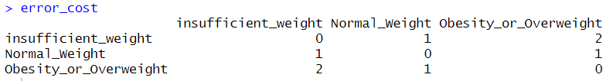
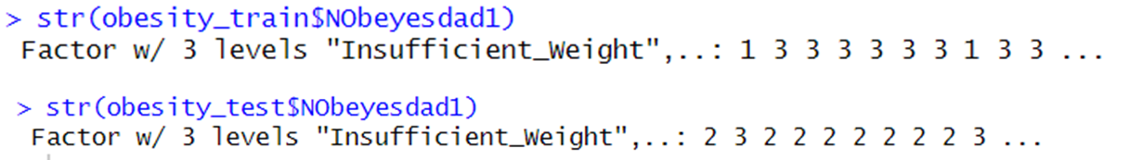
Efforts to simplify the cost matrix
After setting up the 7x7 cost matrix => The C5.0 algorithm with the cost specified was not able to run smoothly.
It could be because the cost matrix is too large => tried to simplify the matrix to be a 3x3 cost matrix instead:
‘Insufficient weight’ and ‘Normal weight’ class remains unchanged
Grouped the rest to be called ‘Obesity_or_Overweight’
Included a new variable ‘obesity_train$NObeyesdad1’ to the train data and test data
‘obesity_train$NObeyesdad1’ is now the 18th class variable => excluded from train data but supplied as the target factor vector for classification
Redo the same steps and apply the cost matrix to the model => results are the same as before

Slide 17
Conclusion
Obesity is a global epidemic that affects millions worldwide. Many tools and solutions have been developed to detect and predict the onset of obesity in children, adults, and the elderly so that effective interventions can be provided.
One of the best data analytics techniques to classify with great precision is a decision tree
Decision tree is a great classification algorithm that has high accuracy across both train and test data.
Boosting decision trees can help in improving the accuracy of the model.
However, this classification might be overly optimistic as the decision tree tends to have overfitting issue
As such it is important to consider other types of classification methods such as random forest as it tends to perform better on unseen data.
Limitations of dataset:
Imbalanced data: Even though there are 7 levels of obesity => there are more records classified under obesity/overweight as compared to insufficient weight/ normal weight
Unsure if the classifications are correct since the BMI is not computed and the classifications of the levels of obesity have not been specified.
One of the ways to improve on the dataset:
Can compute the accurate BMI using height and weight measurements:
Formula: weight (kg) / height (m²) -> cross-checked with the classification in the data to see if it is correct

